Slide 1
INTERNET TRENDS –
Web 2.0 Summit
San Francisco, CA
Mary Meeker – October 18, 2011
www.kpcb.com/internettrends2011
Notes:
1

Slide 2




























KPCB (Digital Venture + Digital Growth) 2011 Investments

Slide 3
Internet Trends
Globality – We Aren’t In Kansas Anymore…
Mobile – Early Innings Growth, Still…
User Interface – Text ➔ Graphical ➔ Touch / Sound / Move
Commerce – Fast / Easy / Fun / Savings = More Important Than Ever…
Advertising – Lookin’ Good…
Content Creation – Changed Forever
Technology / Mobile Leadership – Americans Should Be Proud
Mega-Trend of 21st Century = Empowerment of People via Connected Mobile Devices
Authentic Identity – The Good / Bad / Ugly. But Mostly Good?
Economy – Lots of Uncertainty
USA Inc. – Pay Attention!
Closing Thoughts

Slide 4
Globality –
We aren’t in Kansas anymore…
Notes:
4

Slide 5
Apple, Google, Amazon.com & Facebook Remain Mega-Leaders; Chinese (& Russian) Companies Continue to Step Up
Note: 2011 data as of 10/12/2011; *Facebook market value per most recent trades (week of Sep 26) on SharesPost. Source: Google Finance.

Slide 6
81% of Users of Top Global Internet Properties =
Outside USA
Top 10 Internet Properties by Global Monthly Unique Visitors, 8/11
Source: comScore Global, 8/11.

Slide 7
In 3 Years, China Added More Internet Users than Exist in USA…
China / India / Nigeria / Russia / Iran = Biggest Adders
Note: *Russia data as of 6/10; all other data as of 12/10. Source: United Nations / International Telecommunications Union.

Slide 8
Social Networkers (October, 2011) Exceed Internet Users (December, 2006) & 70% of Them (800MM) Use Facebook
Source: Social Networking users & time spent data per comScore, Internet users data per ITU, Facebook data per Facebook.

Slide 9




If it Plays in Peoria…Take it to Broadway!
Especially in Mobile / Social World…
Company | ‘Test Market’ / Origin* | Social Service | Users
 | UK | Sound Recognition / Music Discovery | 100MM+
 | Sweden | Music Discovery & Streaming | 15MM+
 | Israel | Driving Navigation | 7MM+
 | Germany / UK / Sweden | Sound Discovery & Sharing | 7MM+
Note: *Shazam first gained traction in UK, Spotify first gained traction in Sweden, Soundcloud first gained traction in Germany / UK / Sweden, Waze first achieved critical mass in Israel. All of these services have successfully expanded to other regions / countries, including USA.

Slide 10
Mobile – early innings growth, still
Notes:
10

Slide 11
Breakthrough Communications Technologies / Services Can Breakout Even During Breakdown Times
Technology Adoption (Measured by Population Penetration) in USA
Radio vs. TV vs. Internet vs. Mobile Internet, 1920 – 2011E
Recessions
Source: Radio penetration data per Broadcasting & Cable Yearbook 1996, Internet penetration data per World Bank / ITU, Mobile Internet (smartphone) data per Morgan Stanley Research; 3G data per Informa.

Slide 12
35% Y/Y Global Mobile 3G Subscriber Growth to 936MM (17% of all Mobile Subscribers), Q2:11
Global 3G Stats: Subscribers = 936MM Penetration = 17% Growth = 35%
Note: *3G includes CDMA 1x EV-DO and Rev. A/B, WCDMA, HSPA; One user may have multiple mobile subscriptions and may be counted as multiple subscriber. Source: Informa WCIS+.

Slide 13
Smartphones Surpassed Feature Phone Shipments in
W. Europe (Q2:10) / USA (Q1:11); ROW to Follow
Smartphone Shipments as % of Total Mobile Phone Shipments by Region, Q1:08 – Q2:11
Smartphone > Feature Phone Shipments
50%
Source: Data per Ehud Gelblum, Morgan Stanley Research. Note: In Japan, smartphone exceeded feature phone in Q4:08.

Slide 14
Despite Tremendous Ramp So Far,
Smartphone Usage Still Has Huge Upside
Global Smartphone vs. Mobile Phone Subscribers, 2011E
5.6B Mobile Phone Subscribers
835MM Smartphone Subscribers
Source: Smartphone subscriber estimates per Morgan Stanley Research; Mobile phone subscribers per Informa (as of Q2:11).
Note: While there are 936MM global 3G subscribers as of Q2:11, not all of them were smartphone users. One user may have multiple mobile subscriptions, therefore actual user #s may be lower than subscriber #s.

Slide 15
iPods Changed Media Industry…iPhones Ramped Even Faster…iPad Growth Leaves “Siblings” in Dust
First 6 Quarters Cumulative Unit Shipments, iPod vs. iPhone vs. iPad
Source: Apple, as of Q2:11 (6 quarters post iPad launch).

Slide 16
Android ‘Phone’ Adoption Has Ramped Even Faster than iPhone
First 11 Quarters Cumulative Global Android & iPhone Unit Shipments
Source: Gartner, Morgan Stanley Research, as of Q2:11.

Slide 17
Two Horse Races in Smartphones & Tablets, So Far
Smartphones
Tablets
 | Apple iPhone | Google Android |  | Apple iPad | Amazon Kindle
Cumulative Shipments as of Q2:10 | 129MM | 152MM |  | 29MM | 16MMª
ASP** | $606 | <$600 |  | $650 | <$200
Launch Date | Q2:07 | Q4:08 |  | Q2:10 | Q4:07
Note: a) Kindle shipment estimates per Scott Devitt, Morgan Stanley Research. ** ASP is average selling price, data are estimates for Android and Kindle.
Source: Apple, Morgan Stanley Research.

Slide 18
Mobile Usage –
Big & Ramping Fast
% of Traffic From Mobile Devices, Pandora, Twitter & Facebook, 2008 – 2011
Source: Pandora S1, Twitter, Facebook.

Slide 19
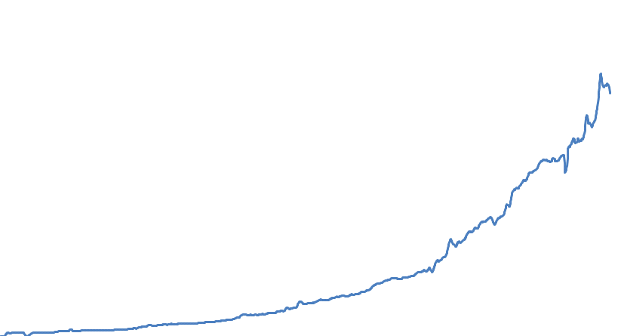
Mobile Search –
Growing Rapidly
Google US Mobile Queries (Indexed), 2007 – 2011
120
100
80
60
40
20
0
4x Growth
in past years
2007
2008
2009
2010
2011
Source: Google.

Slide 20
Mobile Advertising –
Ramping Quickly in all Geographies
InMobi – # of Fortune 1000 Companies Launching Mobile Ad Campaigns & Quarterly Smartphone Ad Impressions, 10/09-9/11
Source: InMobi.

Slide 21
Global Mobile App + Advertising Revenue =
$12B in 2011E Revenue, Up 17x in 3 Years
Global Mobile App + Advertising Revenue, 2008 vs. 2011E
$12B
153% CAGR
$0.7B
Source: Gartner. CAGR is compound annual growth rate.
Note: Apple has paid >$3B $’s to developers as of 9/11, implying gross app market revenue of $4B in 3 years; Google indicated during CQ3 earnings call that it expects $2.5B mobile ad revenue in 2011E

Slide 22
‘Hierarchy of Needs’ Revisited?
1943 – Maslow
2011 – ? ;)
Note: Created for discussion purposes and a bit of humor. Not intended to discredit Maslow's hierarchy, which we believe to be accurate.
Originally presented in Morgan Stanley’s “The Age of Engagement” presentation, dated April 2005

Slide 23
User interface –
Text ➔ Graphical ➔ Touch / SOUND / Move
Notes:
23

Slide 24
What Has One Insanely Great Designer / Entertainer / Leader / Businessman Wrought?
Before Steve Jobs…
computers were utilitarian tools for computation.
After Steve…
computers became beautiful objects we could use in thousands of ways to aim to make life better.
Steve’s design aesthetic was second to none.

Slide 25
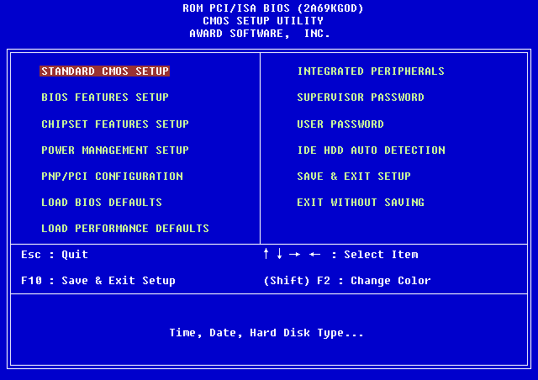
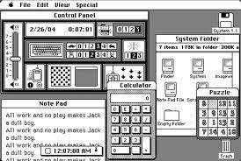
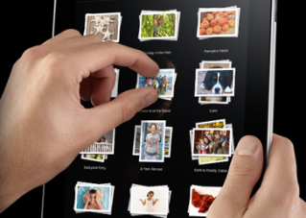
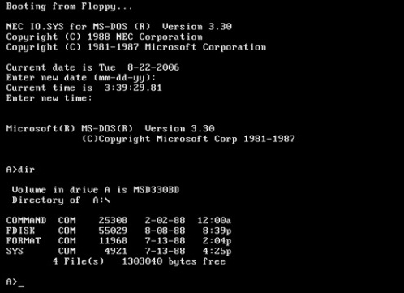
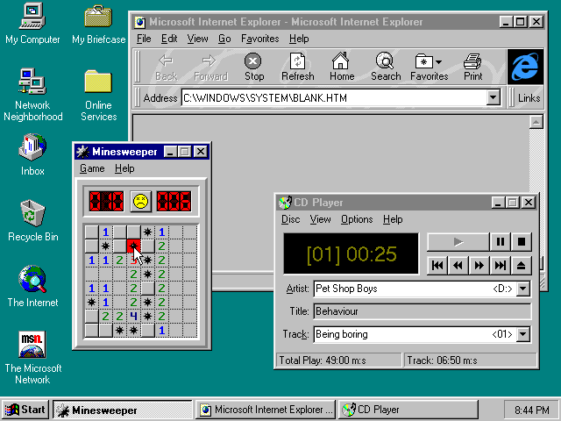
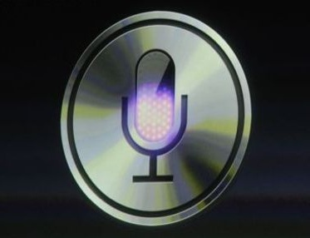
Natural User Interface Revolution –
Now in Touch / Sound / Move Era
1980s
1990s
2000s
Text
Graphical
Touch / Sound / Move

Slide 26


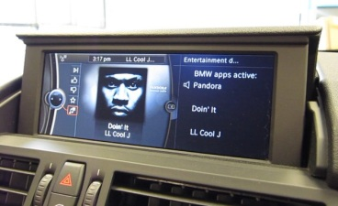
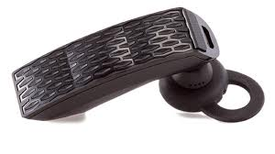

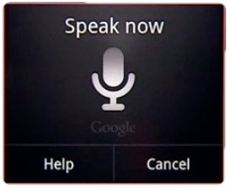


The Next Big Thing(s)?
Those Two Big Things on the Sides of Your Head…
High Quality / Compact Wireless Speakers
Connected
Car Audio
Noise Cancellation / Better Audio Quality
Headsets
Sound Recognition + Understanding
4B+ Bluetooth Enabled Devices
Sound Creation + Sharing
Source: Bluetooth enabled devices shipment per iSuppli and Instat, assumes a 2.5 year replacement cycle.

Slide 27
Perhaps its Time to Hear About the Ear
Sound is going to be bigger than video…
‘Record’ is the new QWERTY.
Alexander Ljung, Founder & CEO, SoundCloud

Slide 28
COMMERCE –
FAST / EASY / FUN / SAVINGS = MORE IMPORTANT THAN EVER…
Notes:
28

Slide 29
eCommerce =
Four Quarters of Accelerating Growth
USA Retail Sales & eCommerce Y/Y Growth Rates, Q1:03 –Q2:11
Note: eCommerce sales excludes travel, auto and auctions. Source: U.S. Census Bureau, comScore.

Slide 30
eCommerce Continues to Gain Share from Offline… at 8% Share of USA Commerce with Lots of Headroom
USA eCommerce % Share⁽¹⁾ of Total Retail Sales, Q1:04 – Q4:13E
eCommerce
Penetration
8% in Q2:11
Note: (1) : e-Commerce share is shown as a percent of DOC’s Total Retail Sales excluding Food Service & Drinking, Food & Bev. Stores, Motor Vehicles & Parts, Gasoline Stations and Health & Personal Care Stores
Source: US Dept. of Commerce, comScore.

Slide 31
Mobile Commerce =
We Have Lift Off!
Mobile Sales or Payment Volume –
eBay / PayPal / Amazon.com / Target / Square, 2009-2011E
Note: Amazon.com disclosed 2010 mobile gross sale, 2009 / 2011 data are KPCB estimates.
Source: eBay, Amazon.com, Target, Square.

Slide 32
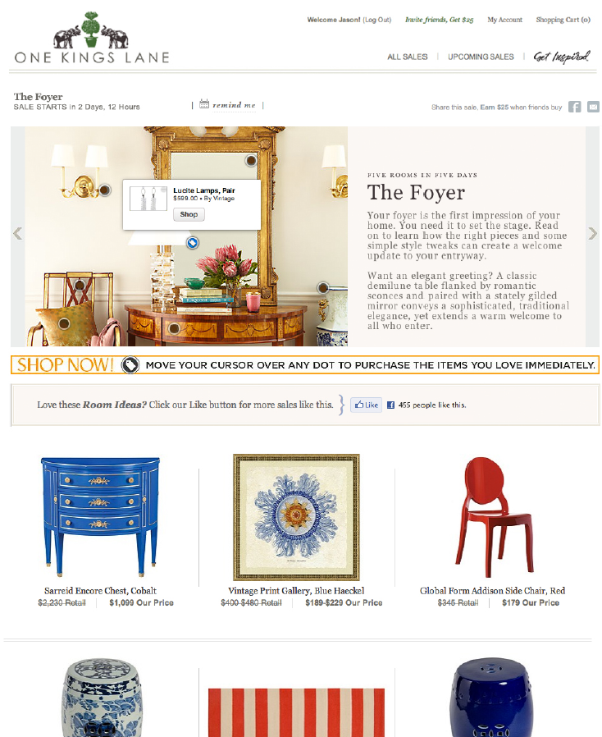
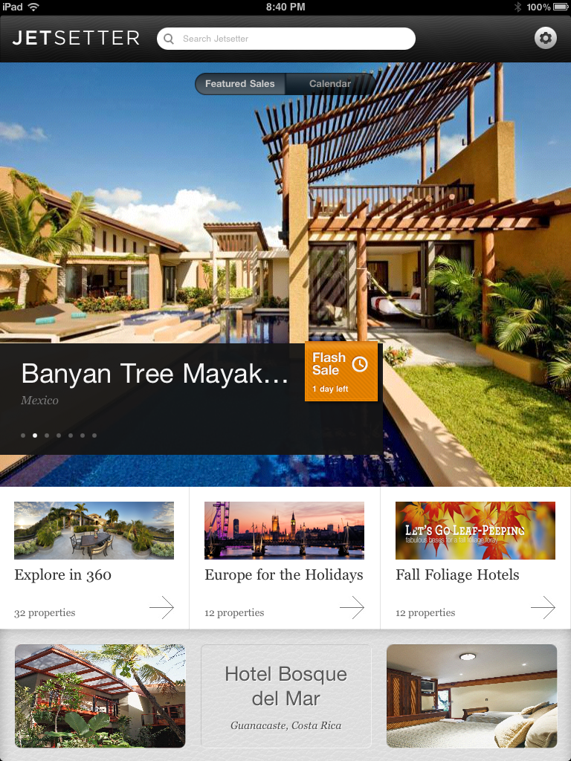
Old Magazine Paradigm Finally Comes Alive =
It’s a Bird, It’s a Plane? It’s Click & Buy (on Mobile Device)…

Slide 33
In a Mobile-ized / Transparent World =
Pricing Matters A LOT!
Reasons for In-Store Purchase Abandonment Among USA Smartphone Users, 7/11
% of Respondents
Source: comScore US smartphone user survey, 7/11.
Note: the same survey also indicated that 50% of USA smartphone users have used their smartphones to find a nearby store. So while mobile Internet is helping drive foot traffic to local stores, it is also helping make pricing info more transparent for the consumers.

Slide 34















Local Commerce =
Rejuvenated by Mobile
Coupons + Demand Generation
Payments + Inventory Management
Reviews + Business Information / Leads
Check Ins + Driving Foot Traffic
20MM+ Users*
2MM+ Users*
40MM+ Users*
15MM+ Users*
LOCAL
COMMERCE
Note: *Users are comScore USA’s aggregate monthly unique visitor data for companies listed under each category.
Total USA local advertising for 2011E is $68B, per Morgan Stanley Research.

Slide 35
Advertising – lookin’ good…
Notes:
35

Slide 36
Media Time Spent vs. Ad Spend Still Out of Whack
Internet / Mobile (upside…) vs. Print (downside…)
% of Time Spent in Media vs. % of Advertising Spending, USA 2010
~$20B
Opportunity
in USA
Note: Print includes newspaper and magazine. $20B opportunity calculated assuming Internet and Mobile ad spend share equal their respective time spent share. Source: eMarketer, 3/11.

Slide 37
Advertising $s Follow Eyeballs –
Ad Revenue per User = $49 in 2011E vs. $0 in 1994E
 | 1995E | 2011E
Global Internet Ad Revenue | $55MM | $73B
Ad Revenue per User | $9 | $49
Global Internet Users | 6MM | 1.5B
Source: Global online ad revenue per Jupiter Communications (1995), ZenithOptimedia (2011). Internet users per Morgan Stanley estimate (1995) and comScore (2011). We note that comScore reports a lower global Internet user # than International Telecommunications Union.

Slide 38
Google Paid Clicks & Cost-Per-Click Continue to Grow Rapidly;
Mobile Helping
 | Q2:10 | Q3:10 | Q4:10 | Q1:11 | Q2:11 | Q3:11
Gross Advertising Revenue ($MM) | $6,562 | $7,032 | $8,167 | $8,306 | $8,716 | $9,335
Y/Y Growth | 23% | 22% | 26% | 28% | 33% | 33%
Aggregate Paid Clicks (MM) | 12,651 | 13,157 | 14,669 | 15,245 | 15,004 | 16,876
Y/Y Growth | 15% | 16% | 18% | 17% | 18% | 28%
Cost per Click (CPC - $) | $0.52 | $0.53 | $0.56 | $0.54 | $0.58 | $0.55
Y/Y Growth | 7% | 6% | 7% | 10% | 12% | 4%
Source: Google, Morgan Stanley Research.

Slide 39
Time Spent on Social Networking Sites Surpassed Portals, June 2011, USA
USA Monthly Time Spent, Portals vs. Social Networking Sites, 6/08 – 7/11
June 2011 Time Spent
Social Networking > Portals
Source: comScore Media Metrix USA panel-only data.

Slide 40
Social Networking CPMs =
Have Begun to Punch Closer to Their Weight
Share of Total USA Online Display Ad Units (as of 8/11) + CPM (as of Q3:11),
by Top Publisher Categories
Source: comScore, Display ad unit share as of 8/11, CPM data per Vivaki, as of Q3:11.
Notes:
40

Slide 41
CONTENT CREATION –
CHANGED FOREVER…
Notes:
41

Slide 42
Content Commoditization –
Value Shift from Creators to Aggregators
Newspapers, once the bastions of content creation / curation, are experiencing 5th straight year of declining revenue.
With undifferentiated products, price is competed down to marginal cost. And the marginal cost for digital content is $0.
How does one create differentiated content in an economically viable manner, when few want to pay for it? – For insights, check out Joanne Bradford’s Web 2.0 presentation.
USA Total Newspaper Print + Online Revenue vs. Google USA Revenue, Q1:06 – Q2:11
Source: Demand Media.
Note that Search = ~50% of USA Online Ad Revenue ($15B based on Q2 run rate) in 2011 vs. <5% in 2001; Display = 23% of Online Ad Revenue ($7B) in 2011 vs. 62% in 2001

Slide 43
Technology / mobile leadership –
Americans should be proud
Notes:
43

Slide 44
We are Living Through a Once Every 10-20 Years Technology Evolution – The Mobile Computing Cycle…
Smartphones + tablets outshipped PCs (notebooks + desktops) in Q4:10.
Windows operating system fell to installation on <50% of Internet-enabled devices in Q2:10.
Source: Morgan Stanley Research, Gartner.

Slide 45
‘Made in USA’ Smartphone Operating Systems =
64% Share from 5% Five Years Ago
Smartphone Operating System Market Share, 2005 vs. 2011E
Source: Morgan Stanley Research, Gartner.

Slide 46
Still Early-Innings Era of Smart-Phones to Smarter-Phones
Pace of innovation in Silicon Valley may be unprecedented.
Intensity / focus / leadership of USA-based companies (Apple / Google / Amazon.com / Facebook) may be unprecedented.
Combination of technology improvements and elegant design may be unprecedented.

Slide 47
Mega-trend of 21st century = empowerment of people via connected mobile devices
Notes:
47

Slide 48
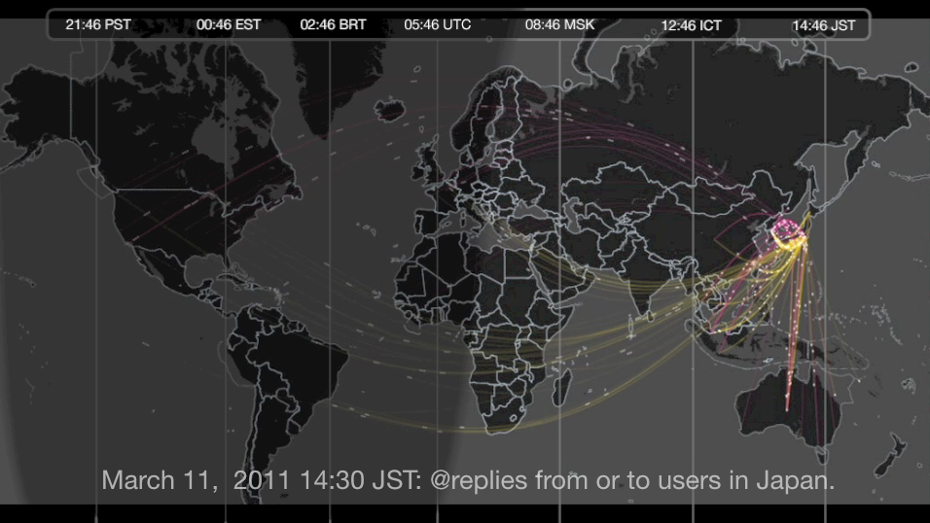
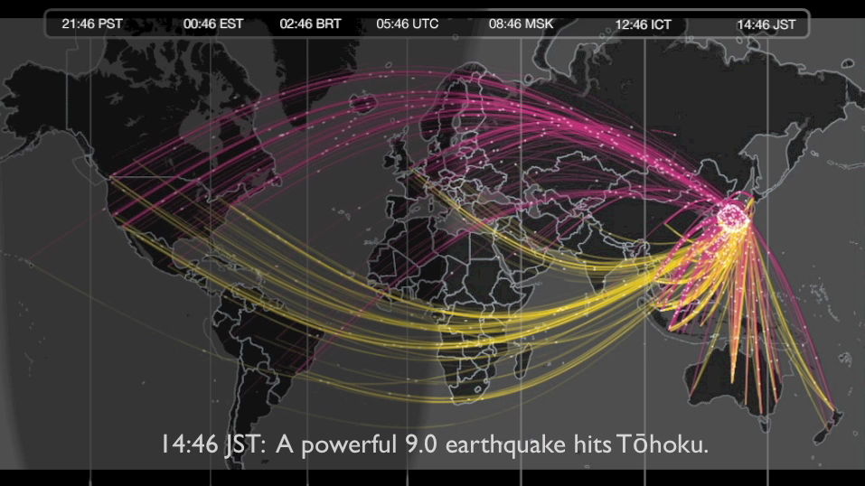
Global Information Flow -
Real-Time + Fast + Broad
16 Minutes Before / After Japan Earthquake on 3/11/11
Snapshots of @replies From & To Twitter Users in Japan
2:30pm Japan Time
Before Earthquake / Tsunami
2:46pm Japan Time
After Earthquake / Tsunami
In 140-character bites, the story unfolded: the shock and terror; the sense of human frailty mixed with lifesaving information; the messages of those seeking comfort and those seeing some kind of divine retribution, all mixing at hyper-speed.
– LATimes, 3/11/11
Note: Yellow lines indicate tweets coming out of Japan; Pink lines indicate tweets coming into Japan. Source: Twitter.

Slide 49
Global Information Flow –
Remote Locations Getting Connected
85% of world’s population covered by commercial wireless signals, providing greater reach vs. electrical grid (80%).*
200MM+ farmers in India receiving government payments / subsidies via mobile devices.**
Source: *GSM Association, United Nations. **There are 90MM Kisan credit card users and 118MM job card users, both of which do not require bank accounts but utilize mobile phones as identity verification / payment confirmation, per Ministry of Rural Development, Government of India.

Slide 50
Global Economies / People =
Increasingly Connected / Co-Dependent
World Trade as % of World GDP, 1960 - 2010
2010 World Trade =
24% of World GDP
Note: World trade calculated as the sum of all countries’ imports (or exports). The biggest trading partners of USA includes EU nations, Canada, China, Mexico, Japan and South Korea. Source: Trade data per World Trade Organization (WTO), GDP data per United Nations (UN).

Slide 51
Authentic identity – the good / bad / ugly.
But mostly good?
Notes:
51

Slide 52
Authentic Identity – The Good / Bad / Ugly.
But Mostly Good?
With 800MM global active Facebook users…50% that log on in any given day…with an average of 130 friends…and an average of 80 community pages / groups / events…and more than 250MM photos uploaded per day and 350MM active mobile users…*
And 835MM smartphone users (likely ramping to 1.4B within two years)…
It’s hard to hide. The ‘truth’ is often just a photo/click–send away.
‘Clean, well-lighted place to do business?’ ‘People are basically good?’
In a world with tremendous uncertainty – owing to the rapid ramp in always-on, connected citizens of the world, perhaps, the world is on the cusp of being safer than ever?
There are lots of sacrifices. This is new terrain.
Only time will tell how all this plays out…
Source: Facebook, 10/11.

Slide 53
Economy – lots of uncertainty
Notes:
53

Slide 54
Stock Market Volatility =
2x Historical Average, Illustrating Uncertainty
Chicago Board Options Exchange (CBOE) Volatility Index (VIX), 1990 – 2011 YTD
Current (10/11) Level = 40%
1990-2011 Average = 20%
Note: Data as of 10/11. VIX is a measure of implied volatility of S&P 500 index options.
Source: CBOE, Morgan Stanley Research.

Slide 55
Consumer Confidence =
Well Below Historical Average, Illustrating Uncertainty
The Conference Board Consumer Confidence Index, 1978 – 2011 YTD
30 Year Average
CCI = 92.7
10/11
CCI = 45.4
2/09 Trough
CCI = 25.3
Note: Index started in 1967 / benchmarked to 1985=100. The Index is calculated each month on the basis of a household survey of consumers' opinions on current conditions and future expectations of the economy. Source: The Conference Board, 10/11.

Slide 56
USA Corporate Capital Spending Budgets =
Being Revised Down, Illustrating Uncertainty
Survey Results of Corporate Capital Spending Budget Revisions, 1/08 – 7/11
Think about your company’s overall capital budget for the current quarter, have there been any adjustments made over the past 90 days?
23% of Respondents Have Revised Capital Budgets Lower in CQ3:11
Source: ChangeWave Research.

Slide 57
GDP Growth Forecasts =
Being Revised Down, Illustrating Uncertainty
Note: Data is annual GDP percent change. Source: IMF World Economic Outlook, 9/11.

Slide 58
Stock Markets = Often Leading Indicators of Economic Activity
Russia -33% from 52-Week High; Oil (-24%) / China (-23%) / Europe (-23%) / S&P500 (-12%) / Nasdaq (-9%)
Stock / Commodity Markets Performance (% Change From 1/10), 1/10 – 10/11
New 2-Week Trendline?
Note: All values are indexed to 1 (100%) on Jan 1, 2010. Data as of 10/17/11.
Source: Morgan Stanley Research, Yahoo! Finance.

Slide 59
Usa inc. –
Pay attention!
Notes:
59

Slide 60
America’s Revenue & Expenses as % of GDP Over 110 Years;
Current State = Revenue Problem? Spending Problem?
USA Inc. Revenue & Expenses as % of GDP, 1901 – 2011E
Biggest Peace Time Gap Between Revenue & Expenses in USA History
Source: 1910 – 1930 per Census Bureau, 1940-2010 per White House OMB. Real GDP adjusted for inflation, in 2005 dollars.

Slide 61
America’s Income Statement –
-60% Net Margin in F2010
USA Inc. Profit & Loss Statement, F1995 / F2000 / F2005 / F2010
…
…
…
Comments
On average, revenue grew 3% Y/Y over past 15 years
Largest driver of revenue
Payroll tax on Social Security + Medicare
Fluctuates significantly with economic conditions
Includes estate & gift taxes / duties & fees; relatively stable
On average, expense grew 6% Y/Y over past 15 years
Significant increase owing to aging population + rising healthcare cost
Includes education / law enforcement / transportation…
Includes discretionary spending on TARP, GSEs, and economic stimulus
Significant increase owing to on-going War on Terror
Decreased owing to historic low interest rates
USA Inc. median net margin between 1995 & 2010 = -8%
Note: USA federal fiscal year ends in September; *individual & corporate income taxes include capital gains taxes. Non-defense discretionary includes federal spending on education, infrastructure, law enforcement, judiciary functions… Source: White House Office of Management and Budget.

Slide 62
America’s Debt Level Relative to Other Countries –
You Do the Math…
Note: Ranking excludes countries with gross government debt less than $10MM in 2010. Gross government debt includes intragovernment obligations (such as Treasuries held by the Social Security Trust Fund in US’ case).
Source: The International Monetary Fund (IMF).

Slide 63
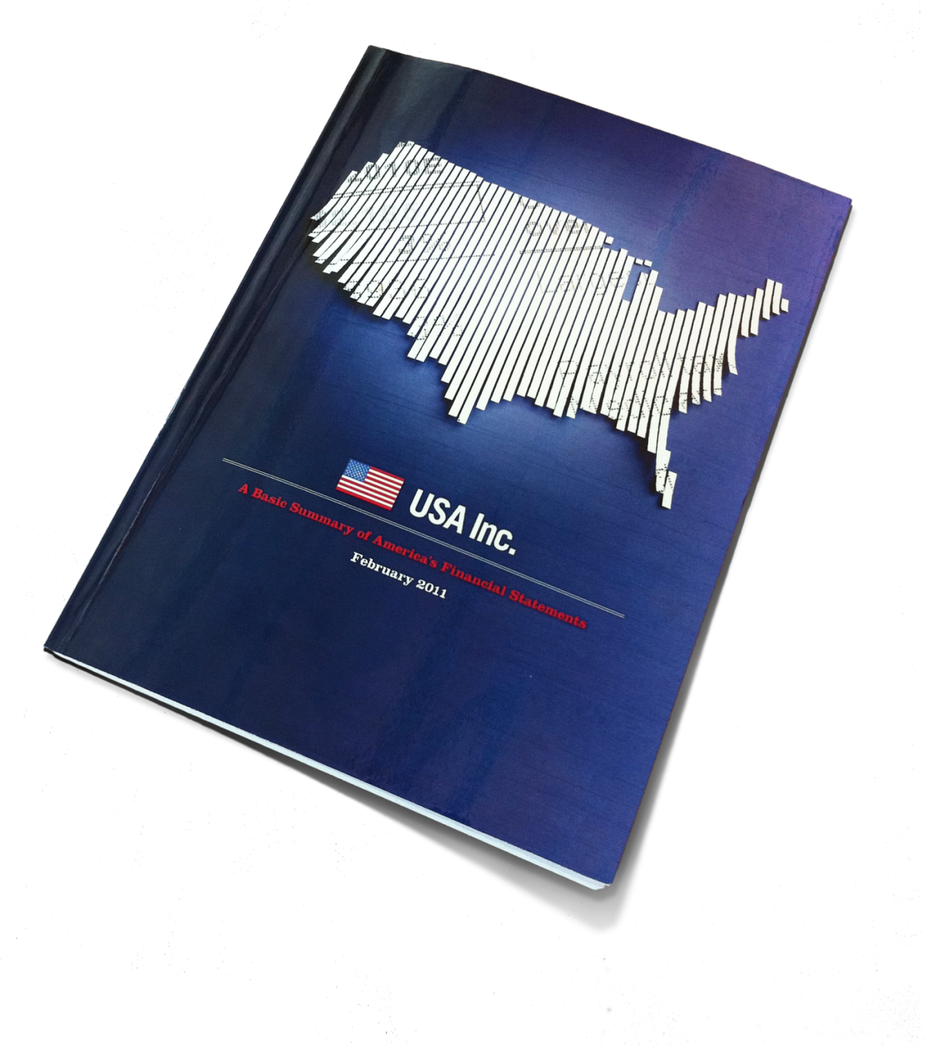
USA Inc. @ kpcb.com / youtube.com / amazon.com
90K+ Total Views
14K+ YouTube Views
7K+ Facebook Likes
2K+ Retweets

Slide 64
Closing Thoughts
Notes:
64

Slide 65
Economy – Often darkest before dawn. At least we know what the problems are. Now we need the resolve to fix them. Across-the-board sacrifice needed.
Tech Industry – Wow! Unprecedented times! If you can keep your head when all about you are losing theirs…*
*Rudyard Kipling - ‘If’

Slide 66
Disclosure
The information offered in this presentation speaks to industry trends in general, and should not be construed as providing any particular recommendations or analysis for any specific company that is mentioned in this presentation. KPCB is a venture capital firm that owns significant equity positions in certain of the companies referenced in this presentation.

